Slide 1
Tools for Low-Speed Mixed Signal System Design
Presented By:
<<Your Name Here!>>

Slide 2
FAQ
Q: Where is the code for this workshop?
A: The pyadi-iio AD5592r class and curve tracer examples are part of pyadi-iio: https://github.com/analogdevicesinc/pyadi-iio/tree/master/examples/ad5592r_examples
Q: Where do I get the Kuiper Linux SD card image for my Raspberry Pi?
A: The image is located here: Kuiper Linux Wiki Page.

Slide 3

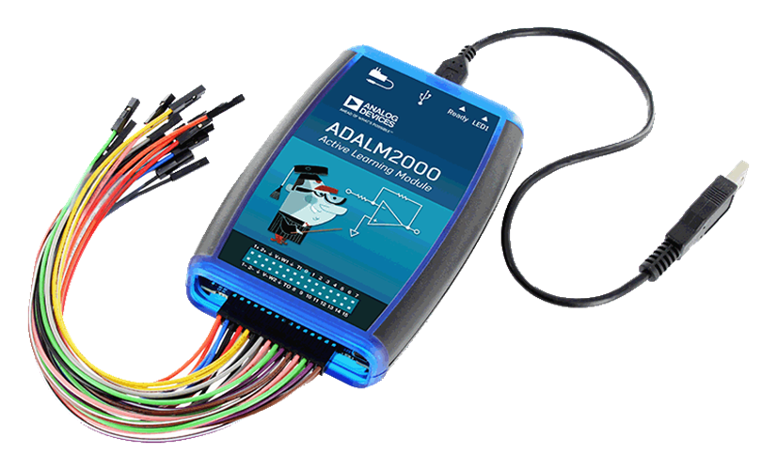
Recommended Preparation
If you’ve never touched Python before, head straight to learnpython.org and go through the “Learn the Basics” lessons. Now. Seriously. It doesn’t get any easier than this, programs actually run, but in the browser, no installation necessary.
If you prefer paper, Python for Kids by Jason R. Briggs is surprisingly good for adults, too.
As usual, Google, YouTube, Udemy, etc. are your friends. Find something that suits your style.
Get either an ADALM2000 or ADALM Pluto, follow installation directions.
Install Putty (https://www.putty.org/ ) or your favorite terminal, log into 192.168.2.1 (user: root pw: analog)
Run iio_info and observe.
Run “ps | grep iiod” to see the thing that lets you connect remotely
On your local machine, open a command prompt, run “iio_info” and watch it fail
Run “iio_info –n 192.168.2.1” and compare!
Public writeup of related tutorials:
https://wiki.analog.com/university/labs/software/iio_intro_toolbox
https://wiki.analog.com/university/labs/software/precision_adc_toolbox
This session will also be written up this way.
Notes:
Presenter: Don’t read this slide – show of hands:
Who is a Python expert
Who knows enough Python to be dangerous (and use it for the occasional work-related task)?
Who is a complete novice?
In order to follow the procedure in this session, you don’t need much Python expertise, but more than zero. Luckily there exists a plethora of plethoras of material out there to suit lots of different learning styles.
Following the procedure in the second section list will give you a bit of a window into the IIO framework, and how data converter-like devices can be accessed either “locally”, on the same machine to which the device is physically connected, or remotely, over a network connection. While a simple concept, think of all of the times you’ve powered up a random eval board, either from ADI or someone else’s installed drivers, connected cables (USB, Ethernet, 9-pin old-school RS-232), crossed your fingers, held your breath, and hoped that nothing failed? IIO is an industry-standard framework that alleviates much of this anxiety.
This slide is re-used from December 2019 training – a handful of people confirmed they went through the adalm2000 / Pluto exercise, so it can be done ☺

Slide 4
Session outline
Objectives: What do we want to accomplish here?
What does “Just Enough Software” look like?
Software Stack Background
Hands-On! Working through a simple, but complete case study
Booting the system
Post-boot housekeeping
Configuring the System (and rebooting!)
Command Line Tools (Hello, AD5592r!)
IIO Oscilloscope
Pyadi-iio And examples
More “Just Enough Software” examples
Drawing parallels to other software flows
This is a nice, long Workshop:
In addition to methodically working through the hands-on exercises, We have time for real-time questions, discussions, suggestions, constructive criticism, etc.
Notes:
Presenter: Don’t read all of this slide, but do touch on the main bullets. Do go over the lower right block.

Slide 5
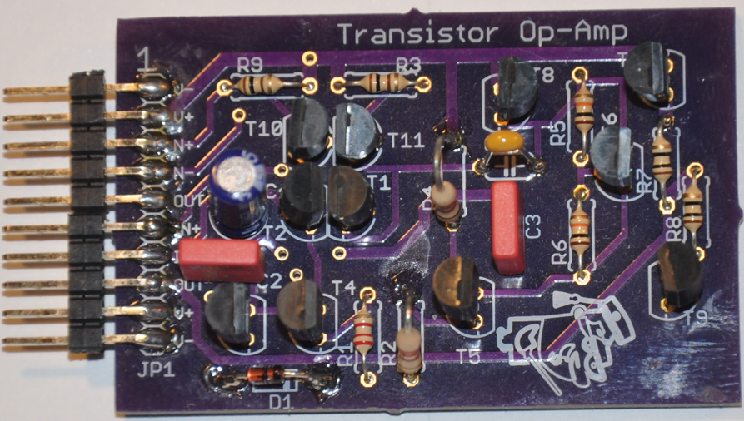
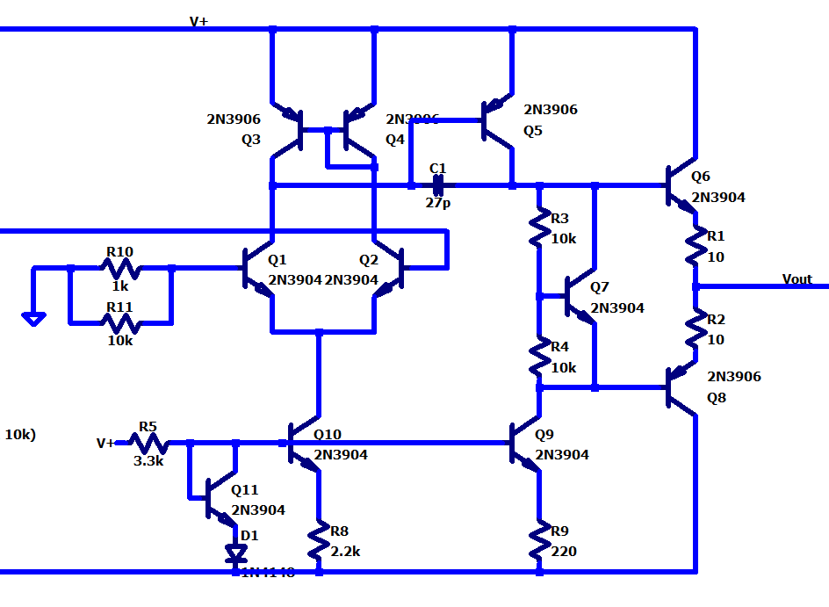
Contests… with Prizes!
There are two contests in this workshop, one hidden, one explicit.
Keep your eyes open for the hidden one ☺
The prizes are U-Solder-It Discrete Op-Amp kits (Doug Mercer’s Design)
Writeup: https://wiki.analog.com/university/courses/electronics/electronics-lab-13
If you don’t want it, give it to a kiddo or your favorite HS teacher or EE prof.

Slide 6
Objectives
Through a hands-on example, Explore hardware and software tools for accelerating customer’s prototyping and proof of concept phases.
Build familiarity with :
Driver examples
Basic command line and GUI tools
Writing simple Python applications “one step beyond” basic examples.
Anecdotal: Getting a customer to “Hello, World!” with a new part is a critical point in the process, this is where you should focus your energy.
Building Linux Kernels
Writing full-featured, fancy GUI software from scratch
UN-Objectives
Notes:
Really, it’s to build a toolbox of skills related to using device drivers – not anything super complicated, but skills that will help you ask the right questions when acting as the “bridge” between the ADI factory and your customer.

Slide 7
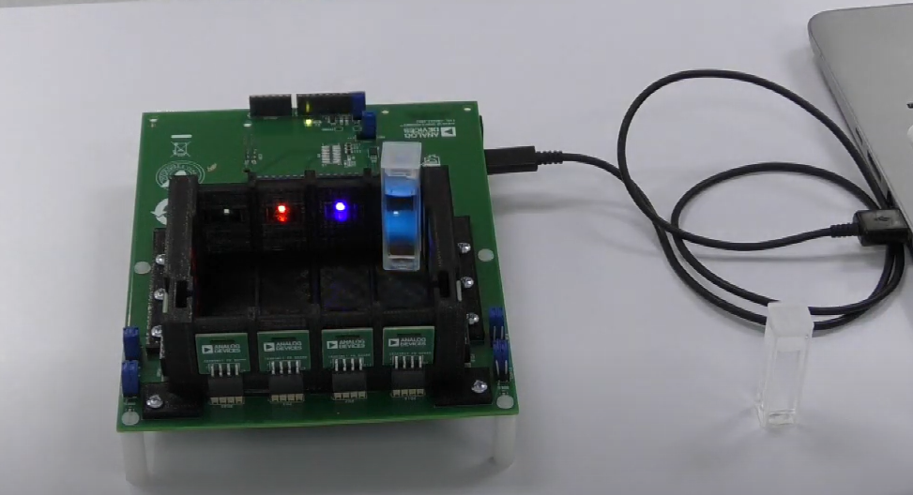
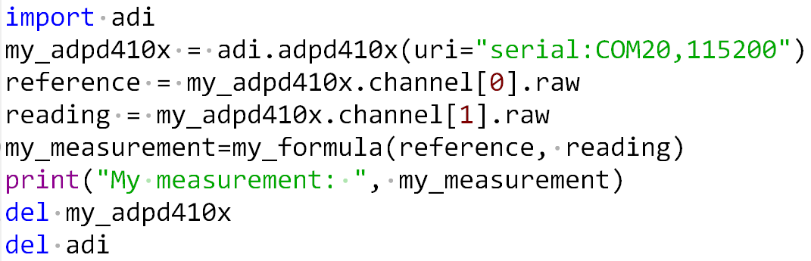
What does “Just Enough Software” look like?
CN0503 Optical Liquid Analysis Platform, Fluorescence Measurement
Python (or MATLAB or C or C# or other) running on host PC
Microcontroller’s Serial Port
(non-CS) subject matter expert can now get to work.
DISTILL applications down to the bare minimum software and hardware that demonstrates the principle and our part’s value proposition.
Is the GUI color scheme important? If not, ignore for now. Is the shape of the enclosure important? If not, ignore for now. (These may be important – ask.)
This is the first of many examples of “Just Enough Software” that we’ll give…
Notes:
Well, here is one possibility. How do I take a MASSIVELY complicated device like the ADPD410x family, and boil it down into something that a sensor expert, chemist, or water quality scientist can bite off and chew and do something useful with it?
Here’s one way – give the customer a reference design in the form of a “server” in which they can configure channels and grab data from them with a minimum of hassle.
And what if the board could be accessed in a consistent manner from Python, C, C#, MATLAB? Sounds like a pretty good deal…
Distill (verb): extract the essential meaning or most important aspects of.
"my travel notes were distilled into a book“
“The customer’s transmorgaphier was distilled into a ramping phased locked loop that requires 1% linearity, and 100ppm frequency accuracy at the endpoints.”
(There is no such thing as a transmorgaphier. But you get the idea – extract the important specifications, what needs to be controlled, what can be ignored during proof of concept.)

Slide 8
“Just Enough” IS buried in a deep stack… But don’t despair, there’s a place where you add LOTS of value:
“pyadi-iio is a python abstraction module for ADI hardware with IIO drivers to make them easier to use.”
Pretty GUI
Customer’s SW dept
Algorithms, number crunching
Pyadi-iio
The rest of us!! (FAE, Product Line Apps, Customer subject matter expert)
“Libiio is a library that has been developed by ADI to ease the development of software interfacing Linux Industrial I/O (IIO) devices.”
Pylibiio (or C#, or MATLAB, etc)
libiio
/sys/bus/iio/../../
Device Driver
Computer Scientist / SW engineer
Platform Driver
HW peripheral (SPI, I2C, JESD)
ADC, DAC, etc.
HDL engineer
kernel.org, github.com/analogdevicesinc/linux
Product Line Apps

Slide 9

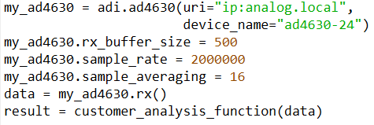
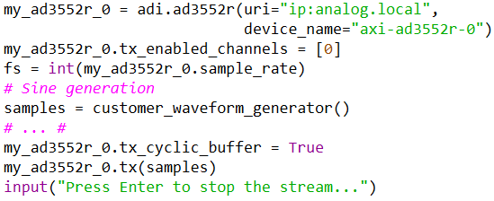
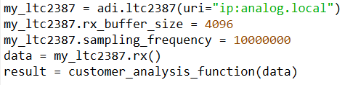
Key Concept: This workshop applies broadly
Brazenly stolen from promotional email
All of these are cutting edge “enabling technology”. But let’s warm up with a…
Notes:
These three devices are being heavily promoted. After this workshop, you should be able to guide the customer to writing their own “just enough software” to analyze ADC data with “customer_analysis_function”, and send data to a DAC from “customer_waveform_generator”.
There may still be quite a bit of work after these initial proof of concept snippets – but if you can get to this point, you’ve climbed a significant portion of the learning curve. (And ideally, sold the customer’s software engineer on the part!)

Slide 10
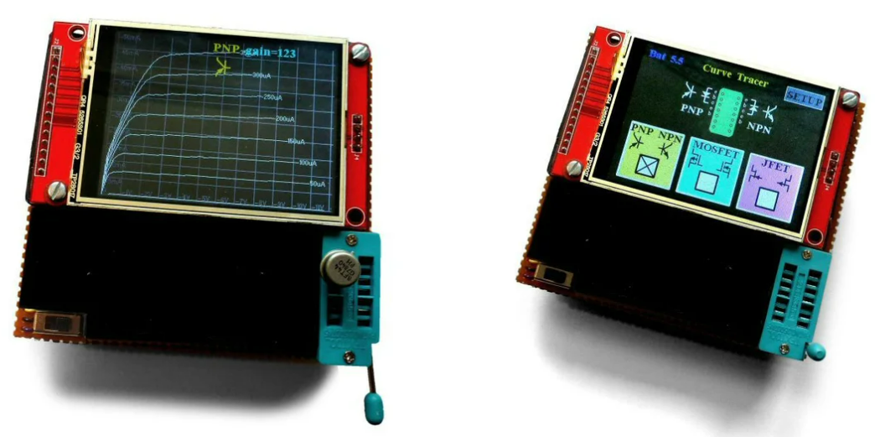
(definitely not contrived) Case Study: Fred in the Shed Instruments pocket curve tracer!
Look out, Keesite, Flook, Techtronicks, Roadie and Schvarts… Fred in the Shed Instruments® is in business!
Let’s help Fred design his first product, the CT001 curve tracer!
Analog circuit (Fred’s Domain)
Choosing ADC/DAC
Proof of concept
Paths to production
Photo Credit:
https://www.instructables.com/Transistor-Curve-Tracer/
Notes:
https://www.instructables.com/Transistor-Curve-Tracer/

Slide 11
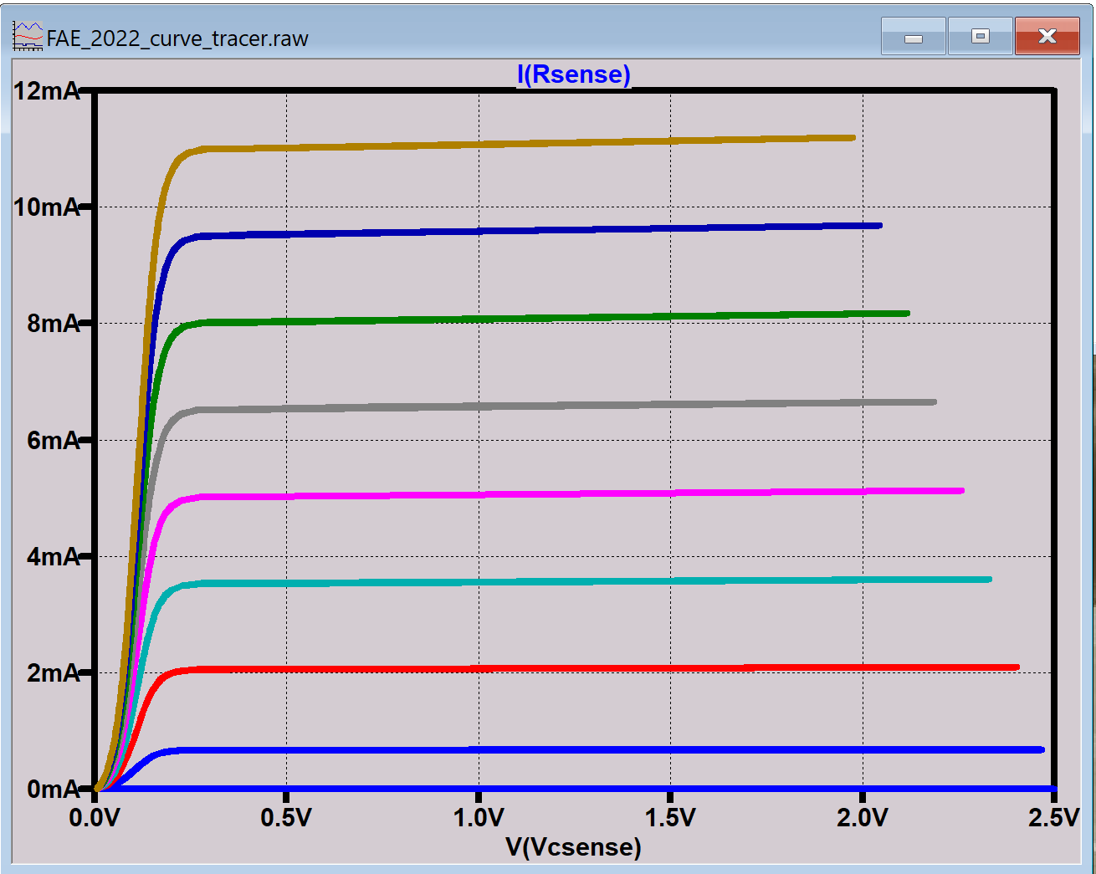
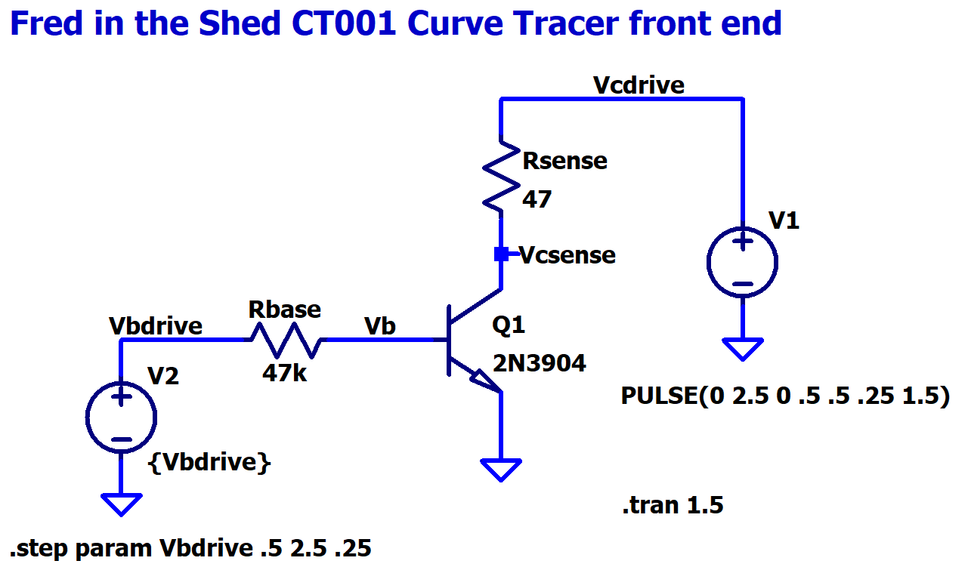
Analog First (Fred’s expertise)
Start with a basic analog circuit, with nodes that will be connected to ADC / DAC channels.
We need to drive Vcdrive and Vbdrive nodes, read back Vcsense.
Notes:
Show of hands – who feels comfortable with this? Chances are, it’s trivial for the anlaog gurus. For the software gurus – what better place to start learning some analog than a little circuit like this ? ☺
The first measurement we want to evaluate with the CT001 is collector current curves for the 2N3904, the most common transistor on the planet.
If you win one of the U-solder-it op-amps, you will get a pile of these.

Slide 12
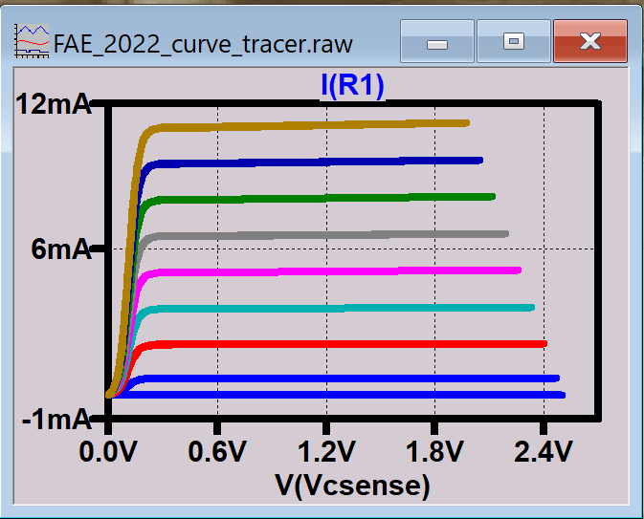
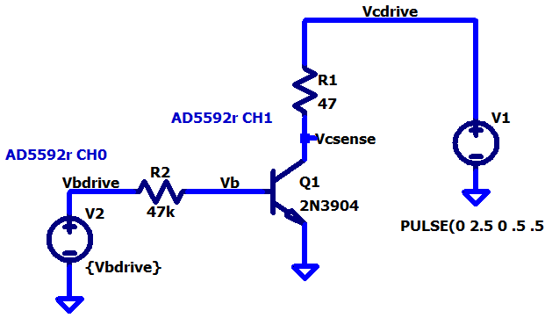
CT001 Stack(s)
Pretty
GUI
Customer’s SW dept
Algorithms, number crunching
Pyadi-iio
The rest of us!! (FAE, Product Line Apps, Customer subject matter expert)
Pylibiio (or C#, or MATLAB, etc)
libiio
/sys/bus/iio/../../
Device Driver
Already done if we pick the right part ☺
Platform Driver
HW peripheral (SPI, I2C, JESD)
ADC, DAC, etc.
Product Line Apps (INL, DNL, Gain error, Drift, Noise)

Slide 13
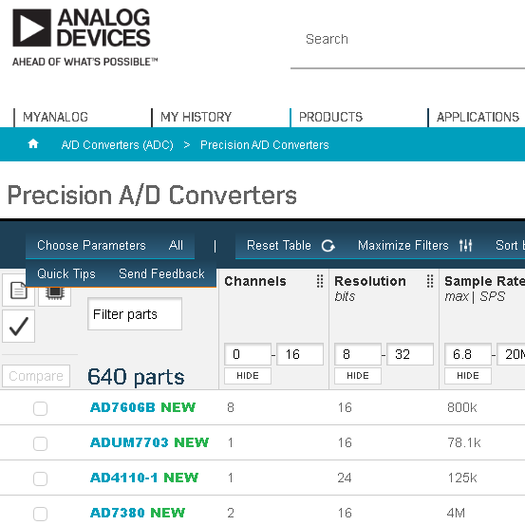
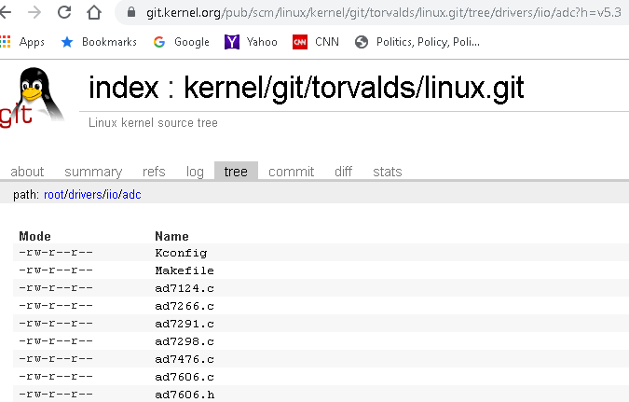
ADC/DAC Selection – where would you start?
Analog.com
OR…
Kernel.org
ADI’s Github (latest development)
https://github.com/analogdevicesinc/linux/
Notes:
Who is making the decisions at your customers? Hardware engineers or software engineers? If it’s software engineers, they will make decisions based on their view of the world – does a driver exist and is it well-supported?
See Michael Hennerich’s presentation on the importance of upstreaming.

Slide 14
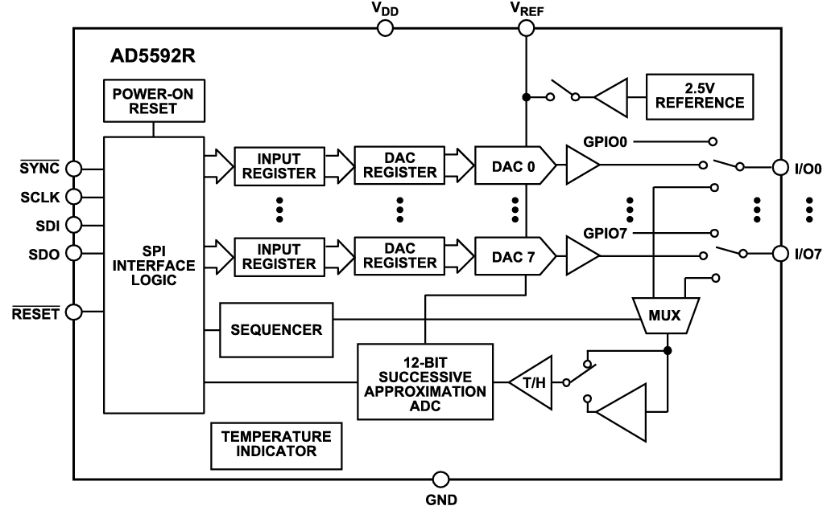
Since we want to plan for future expansion…
AD5592r: Mixed Signal Swiss Army Knife
8 I/O pins, each can be:
Digital Input
Digital Output
Analog Input
Analog Output
Linux driver exists!
And is documented!
No-OS driver exists!
And is documented!

Slide 15
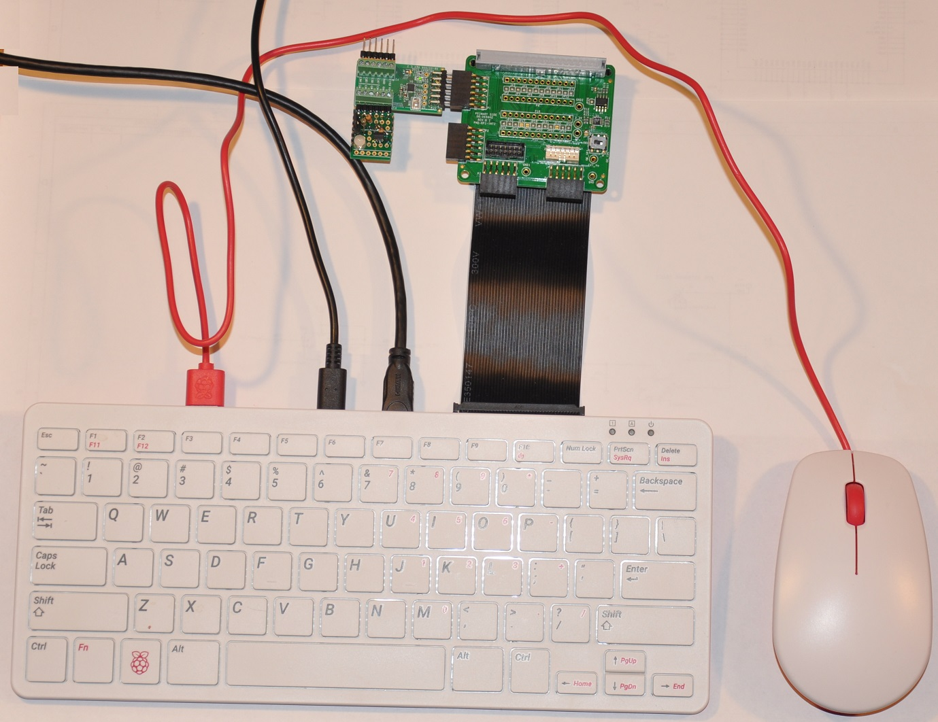
Hardware Setup Quick Check
5 V USB-C adapter
Upper SPI Pmod (P1)
Parts List:
Raspberry Pi 400
Prepared SD card (2021_r2_RC1 w/ goodies)
Corded Mouse
HDMI Micro to HDMI cable
1080p monitor or similar
(OR Ethernet connection to PC, VNC)
5 V USB C Wall Adapter
40-pin M-F ribbon cable
PMD-RPI-INTZ interposer board (w/ protector)
EVAL-AD5592R-PMDZ
Curve Tracer Circuit
Optional:
Slotted Screwdriver
6-pin terminal posts (same as in m2k kit)
Red/Black grabber leads
Genuine Cen-Tech 7-function multimeter
(Accept no substitutes.)
HDMI closest to ribbon cable
SD card slot
DO NOT REMOVE ribbon cable
Notes:
VERY straightforward.
On the ribbon cable – it will be preinstalled for the workshop. If it ever needs to be removed for packing, etc, be CAREFUL – use a gentle, rocking motion pulling gently on the cable. Don’t just pull, you could rip the cable out of the connector and / or bend the pins on the Pi. When in doubt, ask someone that’s done this a thousand times. (Seriously – Raspberry Pis are hard to get.)
Same with the micro HDMI connector. I’ve never broken one, but maybe that’s because I’m super paranoid. Make sure it’s oriented properly, insert STRAIGHT in. Once in, don’t yank around at all.

Slide 16
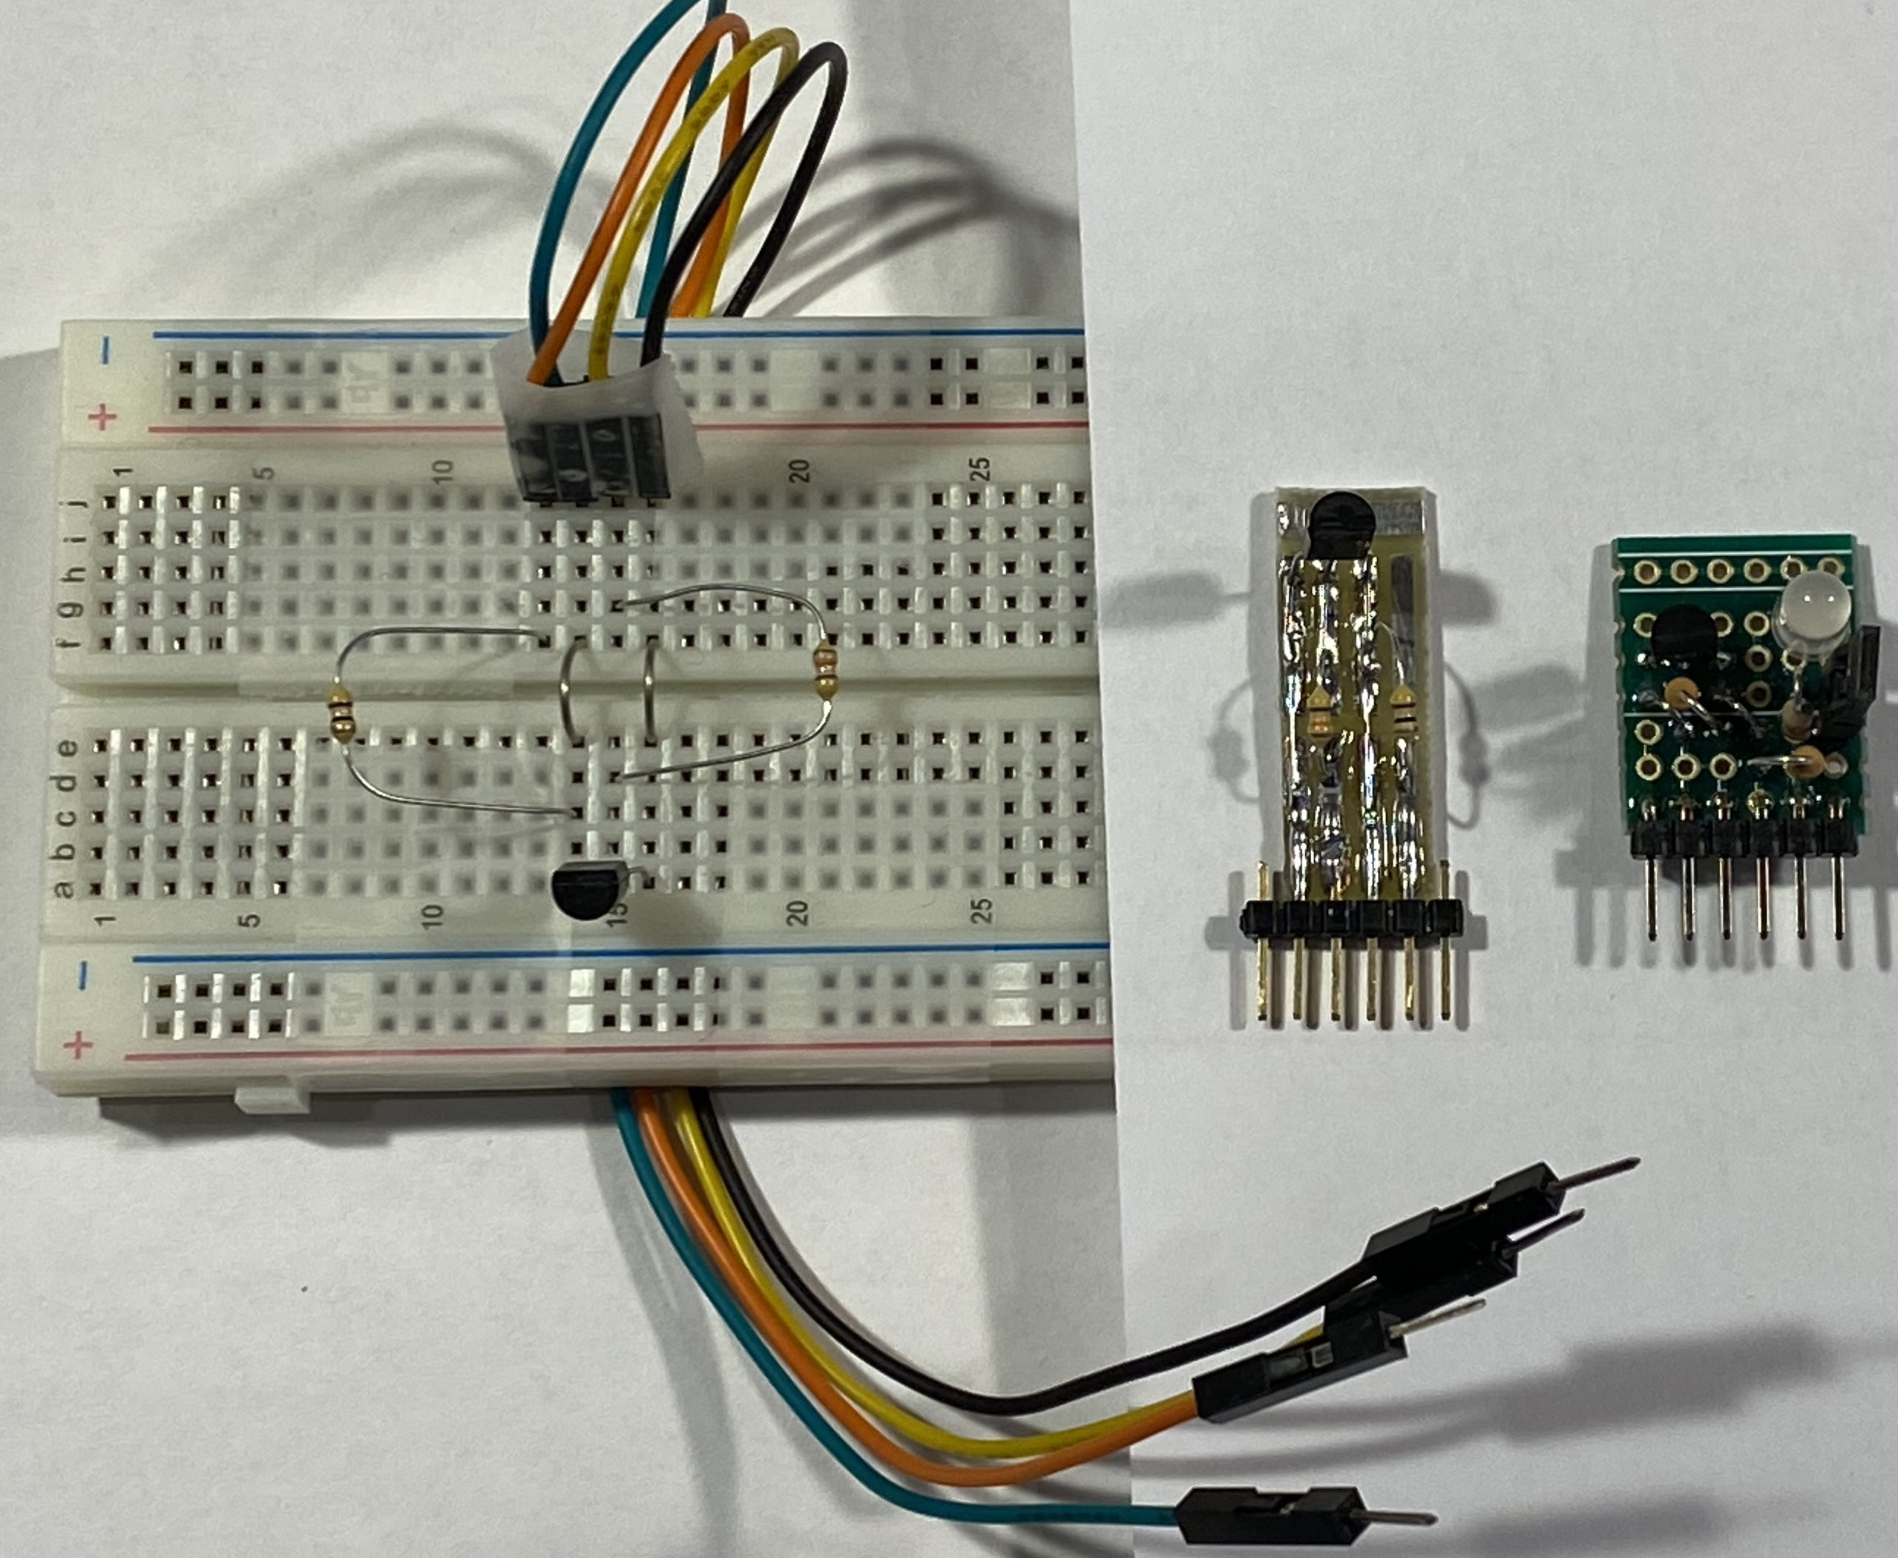
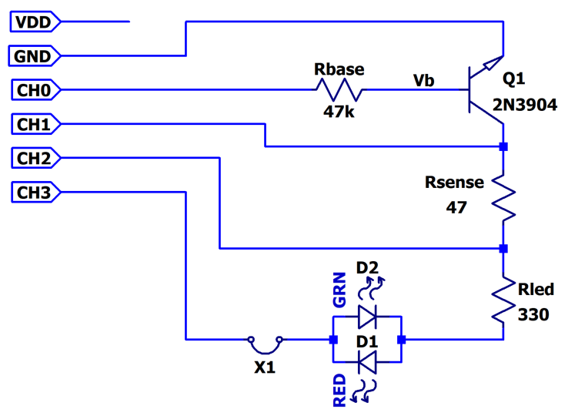
For Reference: Curve Tracer Board Schematic
Print Me

Slide 17
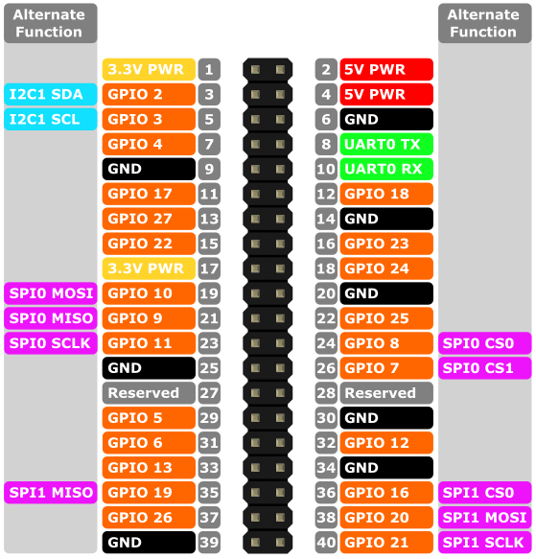
Hardware Connections (via RPI-PMD-INTZ)
Raspberry Pi Expansion Header
Pin Mapping:
CS0 ↔ CS#
COPI ↔ COPI
CIPO ↔ CIPO
SCLK ↔ SCLK
GND ↔ GND
GND ↔ GND
3V3 ↔ VCC
3V3 ↔ VCC
EVAL-AD5592R-PMDZ
NC
7
1
CS#
NC
8
2
COPI
NC
9
3
CIPO
NC
10
4
SCK
COPI
CIPO
GND
11
5
GND
VCC
12
6
VCC
CIPO
COPI
(Alternatively, connect w/ Schmartboard 5” female jumpers)

Slide 18
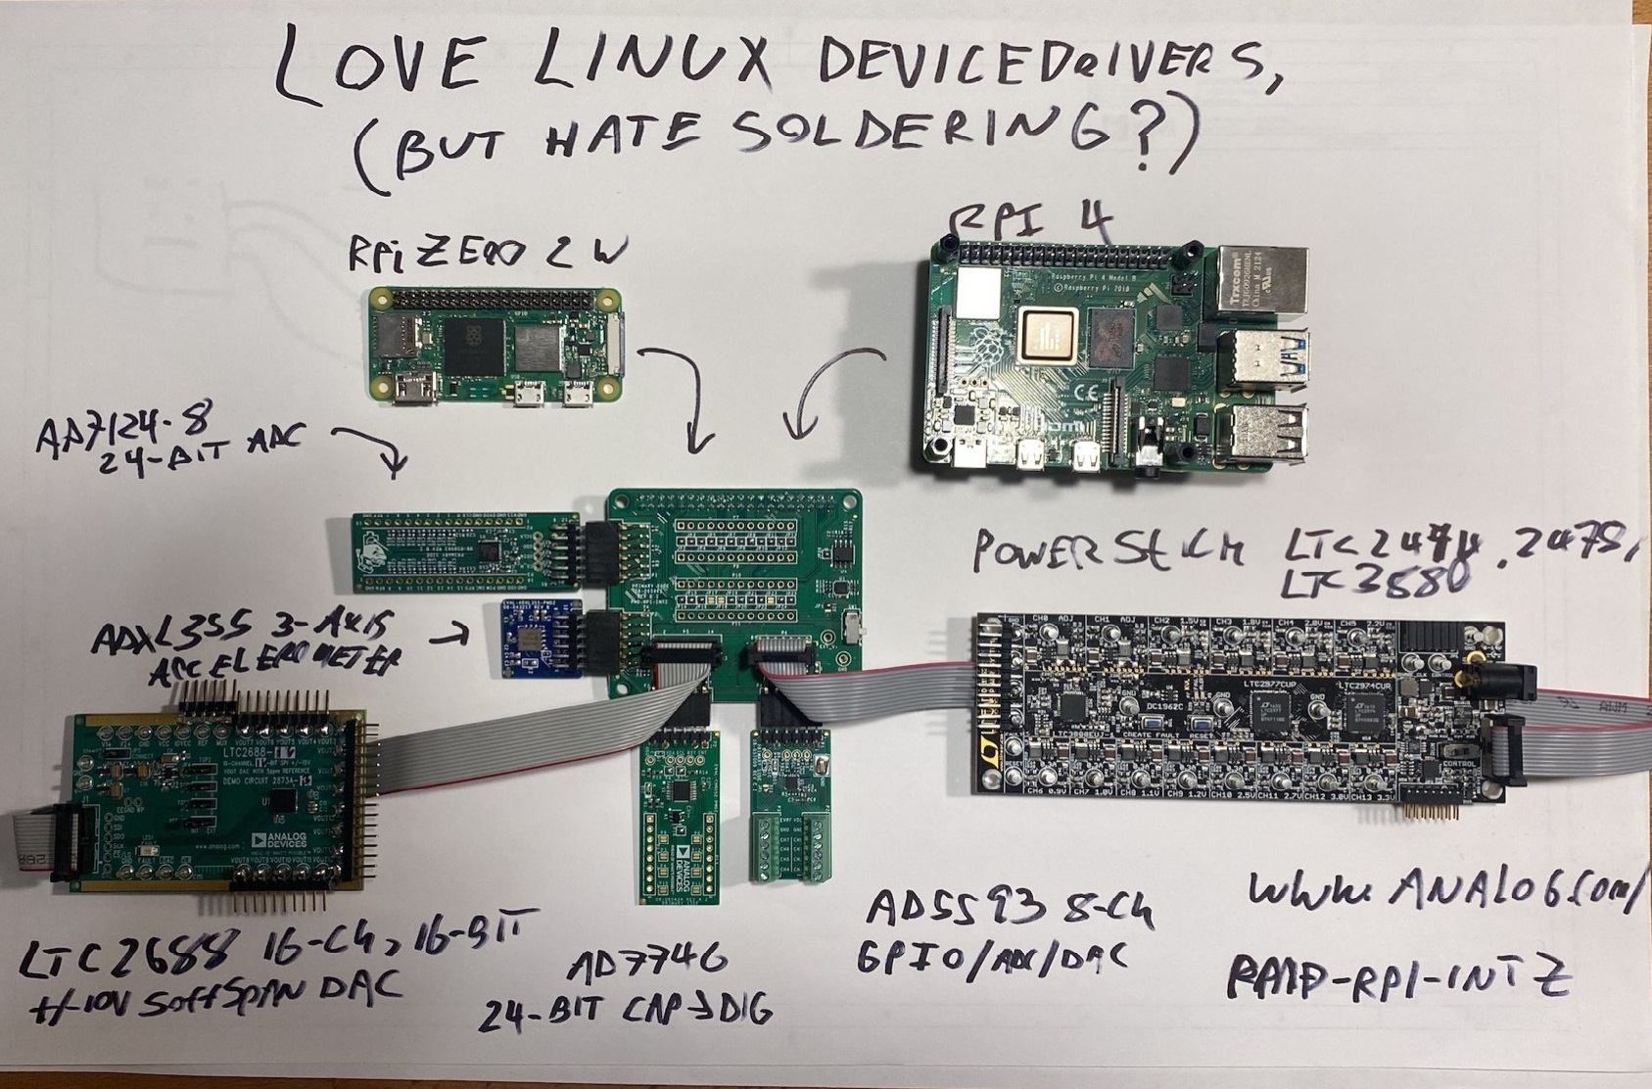
Yup, we’re only using one of six headers ☺
Retake Photo
Shown Here:
LTC2688-16 16-ch DAC
ADXL355 accelerometer
AD7746 Cap-Digital Converter
PowerStick (LTC2974, LTC2977, LTC3880)
AD5593r
All supported in ADI Kuiper Linux and pyadi-iio!

Slide 19

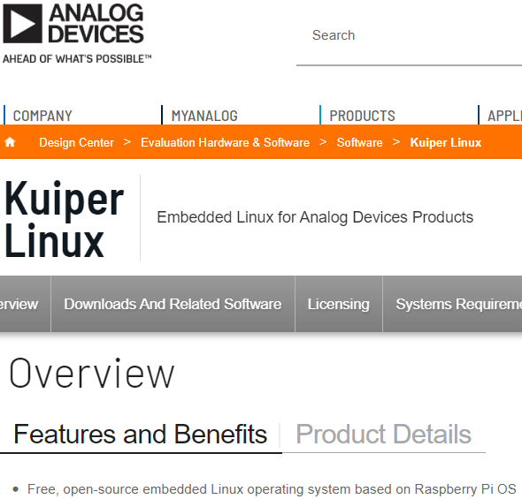
Toolbox Item:
ADI’s own variant of Raspberry Pi OS!
Why? So you don’t have to build kernels, fight with FPGA toolchains, etc.
Gets customer up and running in 5 minutes or less, they can customize later.
Landing Page: https://www.analog.com/en/design-center/evaluation-hardware-and-software/software/kuiper-linux.html
NOT a toy – all projects in CI test flow, board farm in GT
Being used for product line eval: AD4630-24 is the “flagship”
All Linux device drivers for ADI/LT parts enabled
Software libraries: libiio, libm2k, pyadi-iio
GNURadio, IIO Oscilloscope, Python, C compiler
Boot files and “device trees” for example projects
Documentation / instructions: https://wiki.analog.com/resources/tools-software/linux-software/adi-kuiper_images
Notes:
Presenter: Show of hands – who has heard of ADI Kuiper Linux?
Kuiper Linux is a “Romanian Army Knife” with pre-built boot files and Linux kernels for a plethora of Analog Devices hardware.
“Oh, you want to use driver X? Easy, clone the kernel source, switch to this branch, enable the driver in your defconfig, make, make modules install… etc. etc. etc.”
Easy for a software guru to say, not so easy for everyone else. ADI Kuiper Linux’s Raspberry Pi kernel has all ADI and LTC drivers built-in, GREATLY shortening the time it takes to get something useful up and running. (AND… recovery from disaster if your SD card gets corrupted.)
It’s also got a nice collection of utilities installed.
It’s also got Minecraft installed!! (Learn Programming with Minecraft by Craig Richardson uses Python to communicate with the Minecraft world.)
https://www.analog.com/en/design-center/evaluation-hardware-and-software/software/kuiper-linux.html

Slide 20
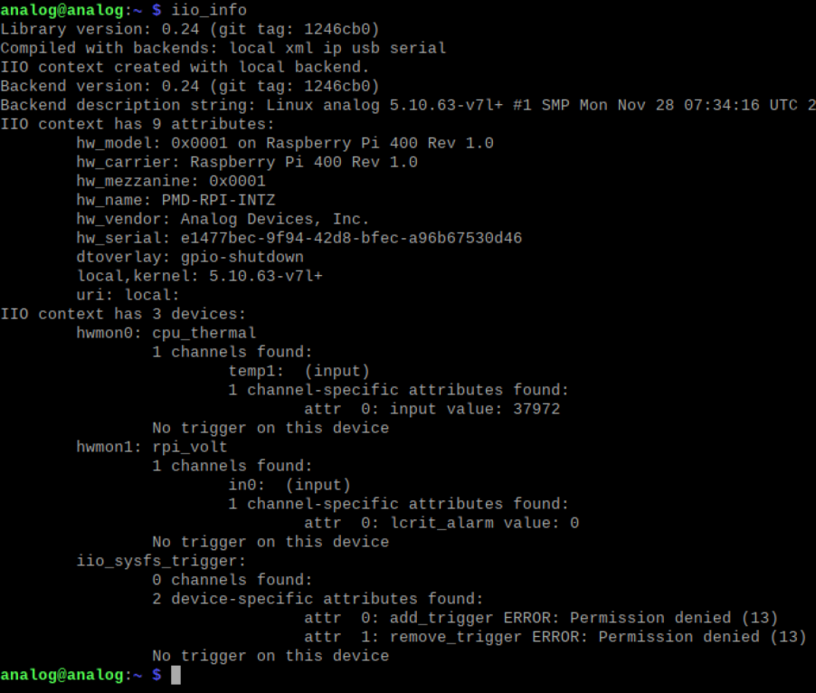
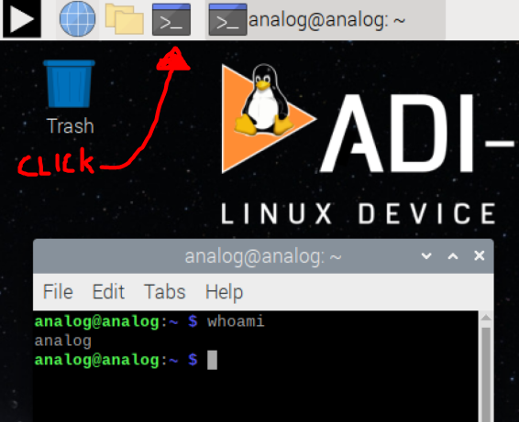
First Time Booting an Unconfigured Kuiper System
Open a terminal
Run:
iio_info <enter>
What devices do you see?
Print Me
Notes:
The AD5592r is physically connected, but unlike a USB peripheral, Linux has no way of knowing that you’ve attached a device, and there’s no way of “scanning” the SPI bus to see if anyone’s connected. Well in theory, the hardware layer would support this – IF every manufacturer agreed that a certain register, accessed in a certain way, contained a unique part number. Couple that with the 4 different SPI modes, different speed limitations, and heterogeneous register mapping and it’s basically impossible.
I2C is a tiny bit better – you can at least probe to see what device addresses are present on the bus. But beyond that, there’s no way to tell who’s there.
But aside from that, what exactly did the “iio_info” command do?

Slide 21

“iio_info?? What in the world is “IIO”?
Linux kernel Industrial Input / Output framework
Not really just for Industrial IO
All non-HID IO
ADC, DAC, TRX, light, accelerometer, gyro, magnetometer, humidity, temperature, pressure, rotation, angular momentum, chemical, health, proximity, counters, amplifiers, synthesizers, etc.
In the upstream Linux kernel for more than 10 years.
**CROSS Platform Libiio library, with LOTS of language bindings **
Mailing list:
linux-iio@vger.kernel.org
https://www.kernel.org/doc/html/latest/driver-api/iio/index.html
Notes:
This is a bit abrupt, but we need to introduce IIO at this point – IIO is a framework for a wide variety of hardware peripherals. It is NOT an Analog Devices invention, it is an industry standard that has been in the Linux kernel for more than ten years.
You can think of it as a “unifying force” for writing software that interacts with hardware, with some extraordinarily powerful features. While the devices themselves need to be physically connected to a Linux based machine, the IIOD server exports devices over network (and other) connections, allowing software to be developed and run on a Windows, Mac, or Linux host. Furthermore, there are language bindings for C, C#, MATLAB, Python, Rust, and more. These are consistent across platforms.
<<Thoren’s perspective>> If you’ve listened to me (Mark Thoren) pontificate over IIO – it is for a reason. I’ve spent two decades developing, and helping others develop ad-hoc evaluation systems, lab bench evaluation setups, customer debug setups, and all manner of hacked setups. They all got the job done, and were done with time, resources, and funds at hand. And they are all terrible in one way or another – unsustainable, one-off, undocumented, etc.
IIO SOLVES 90% of the issues I’ve had over those years. After you get over the initial learning curve and time investment, the long-term benefits are unquestionably worth it.

Slide 22
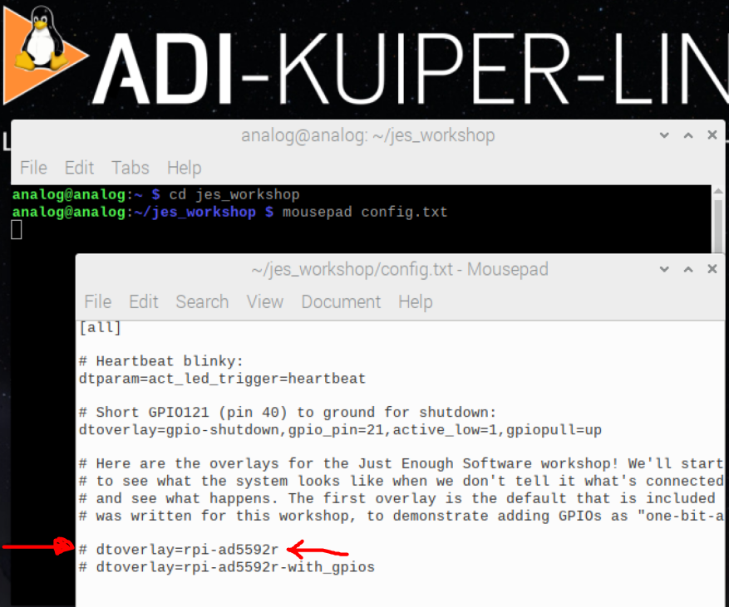
Telling Linux that our AD5592 is there
Open a terminal, enter the following:
cd jes_<tab> <enter>
mousepad config.txt <enter>
Edit local config.txt, un-comment ad5592r overlay
sudo cp config.txt /boot <enter>
Enter super duper secret password: “analog” (without quotes of course)
Shhhhh!!! Don’t tell anybody, it’s super duper secret!
sudo reboot <enter>
Print Me

Slide 23
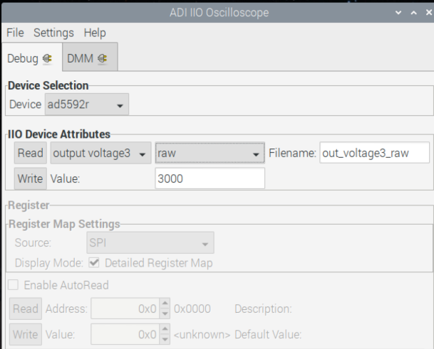
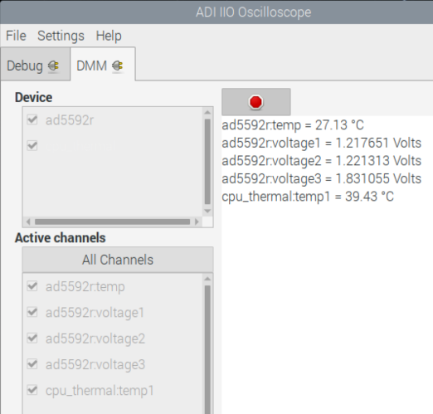
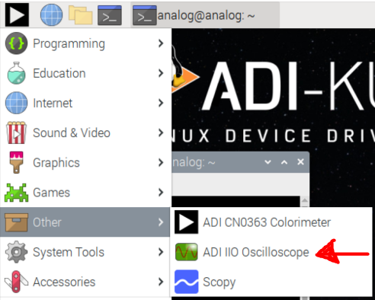
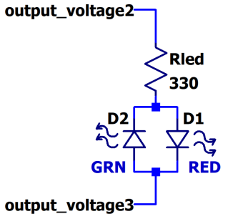
Re-run iio_info, IIO Oscilloscope
Go back and re-run iio_info, observe!
Run IIO Oscilloscope
Explore IIO Oscilloscope panes, channels.
Find a channel that is both input and output, set the output and see if the input changes
BICOLOR LED connected between out 2 and out 3, can you make it light up?
(Hint – drive one output raw value to 0, the other to 4095, then reverse)
If you have a meter, measure the output (or see presenter
Play!
Print Me

Slide 24
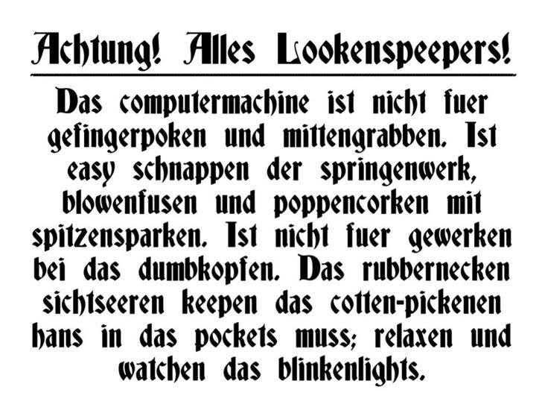
The Importance of Blinkylights
Blinking a light proves that your entire software stack (including your “dtoverlay”) is functional, and your hardware is at least not on fire.
A wise man once said: “If you can blink a light, you can do anything”
(Professor Bruce Segee, University of Maine)
An ADI fellow (Jesper Steensgaard) once said: “That new data converter eval system is great. Show me how to blink a light with it.”
Notes:
Here’s a handy warning you can print out and tape to your projects.

Slide 25
What is a “Device Tree (overlay)”
As an FAE, You do NOT need to know all of this from scratch – there’s plenty of help.
AND – lots of examples included in Kuiper Linux, source on Github. Documented on ADI Wiki. (AD5592, for example)
Tree data structure with nodes that describe the physical devices in a system.
Describes device information in a system that cannot be dynamically detected.
Organized in nodes and properties
Overlays enables addition of extra nodes to the live device tree of an embedded Linux system.
dts: devicetree source
Human-readable
Textual
Used when editing devicetree files
dtb: devicetree blob
Machine-readable
Binary
Flattened
The Device tree compiler (dtc) generates dtb, dtbo
Example file: rpi-adf4159-overlay.dts
/dts-v1/;
/plugin/;
&spi0 {
#address-cells = <1>;
#size-cells = <0>;
status = "okay";
adf4159:adf4159@0 {
compatible = "adi,adf4159";
reg = <0x0>;
spi-max-frequency = <12500000>;
/* Clocks */
clocks = <&clkin>;
clock-names = "clkin";
clock-output-names = "rf_out";
#clock-cells = <0>;
adi,power-up-frequency-hz = /bits/ 64 <6000000000>;
/* --- snip ---- */
};
};
Parent Node – SPI BUS #0
New device node
Driver to bind
SPI Chip Select 0
Properties
Notes:
Stolen from Michael’s GRCon deck

Slide 26
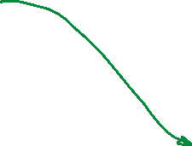
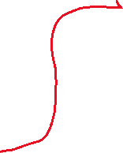
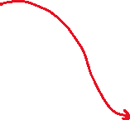


Where the device tree fits in the stack, what it does
target = <&spi0>;
__overlay__ {
#size-cells = <0>;
#address-cells = <1>;
status = "okay";
ad5592r: ad5592r@0 {
compatible = "adi,ad5592r";
reg = <0>;
spi-max-frequency = <1000000>;
spi-cpol;
channel@0 {
reg = <0>;
channel@0 {
adi,mode = <CH_MODE_DAC>;
};
channel@1 {
reg = <1>;
adi,mode = <CH_MODE_ADC>;
};
channel@2 {
reg = <2>;
adi,mode = <CH_MODE_DAC_AND_ADC>;
};
...
...
channel@5 {
reg = <5>;
adi,mode = <CH_MODE_GPIO>;
adi,off-state = <CH_OFFSTATE_PULLDOWN>;
};
channel@7 {
reg = <7>;
adi,mode = <CH_MODE_GPIO>;
adi,off-state = <CH_OFFSTATE_PULLDOWN>;
};
Device Tree Source
Iio_info output
analog@analog:~ $ iio_info
...
...
iio:device0: ad5592r
7 channels found:
voltage3: (input)
3 channel-specific attributes found:
attr 0: raw value: 4095
attr 1: scale value: 0.610351562
attr 2: scale_available value: 0.610 1.220
voltage2: (output)
3 channel-specific attributes found:
attr 0: raw value: 0
attr 1: scale value: 0.610351562
attr 2: scale_available value: 0.610 1.220
voltage3: (output)
3 channel-specific attributes found:
attr 0: raw value: 4095
attr 1: scale value: 0.610351562
attr 2: scale_available value: 0.610 1.220
voltage1: (input)
3 channel-specific attributes found:
attr 0: raw value: 90
attr 1: scale value: 0.610351562
attr 2: scale_available value: 0.610 1.220
voltage0: (output)
3 channel-specific attributes found:
attr 0: raw value: 1000
attr 1: scale value: 0.610351562
attr 2: scale_available value: 0.610 1.220
voltage2: (input)
3 channel-specific attributes found:
attr 0: raw value: 90
attr 1: scale value: 0.610351562
attr 2: scale_available value: 0.610 1.220
...
Pretty GUI
Algorithms, number crunching
pyadi-iio
pylibiio (or C#, or MATLAB, etc)
libiio
/sys/bus/iio/../../
Device Driver
Platform Driver
HW peripheral (SPI, I2C, JESD)
ADC, DAC, etc.
Device Tree controls things at this level, affects above layers
Notes:
When the system boots, the driver reads the device tree and figures out how to configure channel attributes.
Another example – LTC2688 dither modes – either toggle or sinewave, are only configurable at boot time (fixed)
In contrast AD7768 filter modes (SINC or WIDEBAND) are configurable at run-time.

Slide 27

Device Trees: Digging deeper
Of course this exists… https://elinux.org/images/f/f9/Petazzoni-device-tree-dummies_0.pdf
And its YouTube companion: https://www.youtube.com/watch?v=m_NyYEBxfn8
Documented in driver’s wiki page, kernel source.
Kuiper pre-loaded with a plethora of examples.

Slide 28
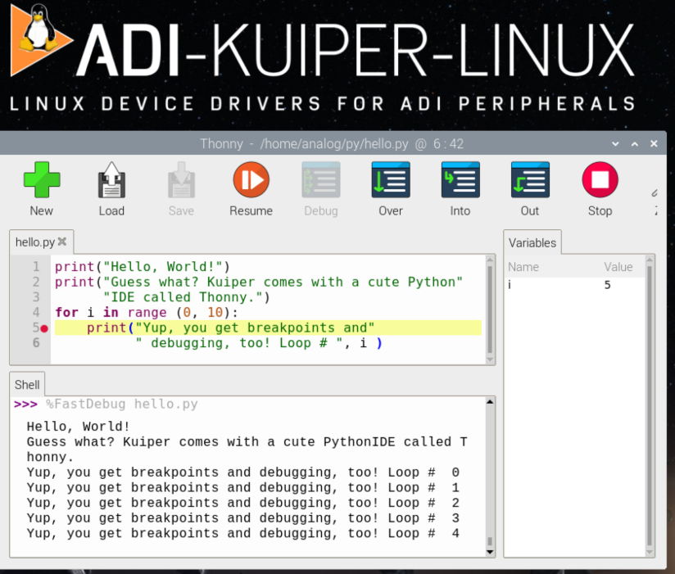
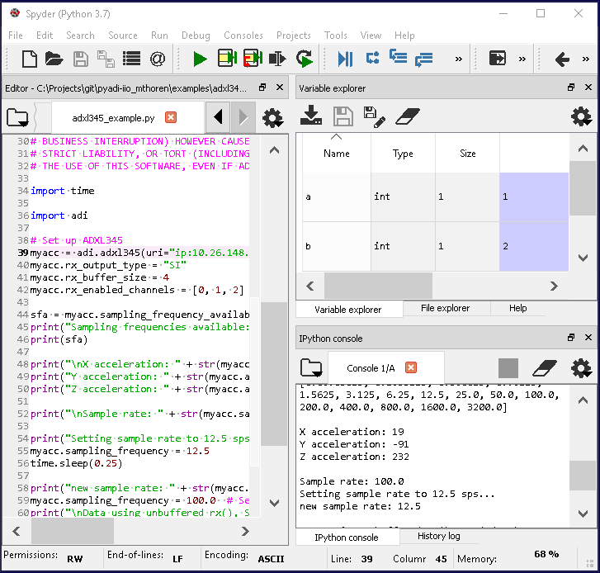
Toolbox item: Python environment
There are lots – largely a matter of preference.
Anaconda, but the cool kids use PyCharm
(The coolest kids use Microsoft VScode)
“raw” installation (Mac, Linux)
Jupyter Notebook
Too many choices? No problem! Kuiper comes with one (Thonny)
Notes:
The best Python environment / IDE is probably the one your neighbors are using so they can help if you run into trouble. While there are differences in how packages are managed, how the debugging functionality works, etc. And assuming all required packages are installed, code you write will work in any of them (or will run from the command line).
The Thonny homepage labels it “Python IDE for beginners”. This is what ships with ADI Kuiper Linux, and is a “real” IDE, with a debugger, breakpoints, watches, etc.
Thonny on Windows or Mac https://thonny.org/
Spyder / Anaconda: https://www.anaconda.com/
PyCharm: https://www.jetbrains.com/pycharm/
Raw installation – generally not recommended, unless you like to micromanage.

Slide 29
Refresher: Hello, World!
Open Thonny from the start menu (Programming -> Thonny)
<<ToDo: Hello, World!>>
Print Me

Slide 30
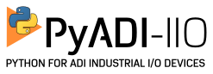
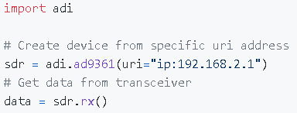
Toolbox Item:
From the Github Readme:
“pyadi-iio is a python abstraction module for ADI hardware with IIO drivers to make them easier to use.”
What pyadi-iio does for us – abstracts the gory details and “goofiness” of libiio, leaving us with a clean, Pythonic interface to our part.
“glue layer” between iio (which has a bit of a learning curve) and doing something useful
Pre-installed on ADI Kuiper Linux
It is hard to overstate just how powerful pyadi-iio is. Coupled with NumPy / SciPy and other modules, it’s ridiculously easy to throw together simple data generation, capture, and analysis scripts.
Grab a chunk of data from an SDR chip in three** lines of code:
** Not counting comments ☺
Notes:
Makes talking to IIO devices REALLY easy – as close to trivial as possible.

Slide 31
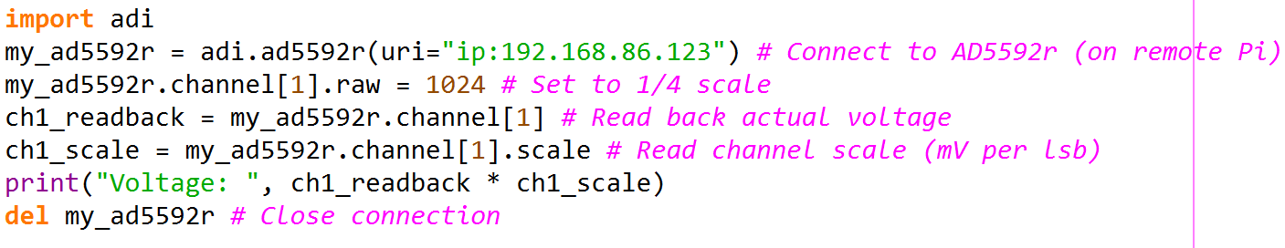
Pyadi-iio for the AD5592r
uri can vary, depending on where you are:
“local:” (read-only for standard users on RPi)
“ip:localhost” (most convenient when run on RPi)
“ip:192.168.86.123” (Your Pi’s wifi/wired address)
“usb:1.2.3” (USB Context ID)
“serial:COM1” (Serial port number)
(From the device tree, channel[1] is configured as an ADC_DAC)
Re-take now that this is fixed ☺
Notes:
Let’s dwell on this slide for a minute… the SAME identical Python code can run:
Directly on the Raspberry Pi, talking directly to the iio API (Needs root privilege to write anything)
Directly on the Raspberry Pi, talking over network to the IIO Daemon (super handy for avoiding permission conflicts)
On a remote Win/Mac/Linux machine, connected via WiFi
On a remote Win/Mac/Linux machine, connected via USB (like the ADALM-Pluto, ADALM2000)
On a remote Win/Mac/Linux machine, connected over serial (not the Raspberry Pi at the moment, but the no-OS example uses this.)

Slide 32
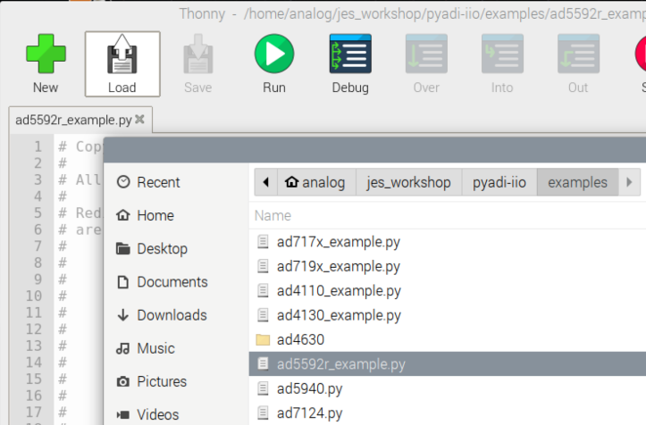

AD5592r Pyadi-iio example
Open Thonny from the start menu (Programming -> Thonny)
Load ad5592r_example.py
(See path in screenshot – enter jes_workshop, then pyadi-iio, then examples, THEN open ad5592r_example.py
(If you can’t resist… see what other examples are in there ☺)
Run!
At the prompts, enter your favorite voltages less than 2499 mV
1234 mV also ideal for luggage combination!
Put a finger on the AD5592r chippy, observe temperature readout
Path to file
Print Me

Slide 33
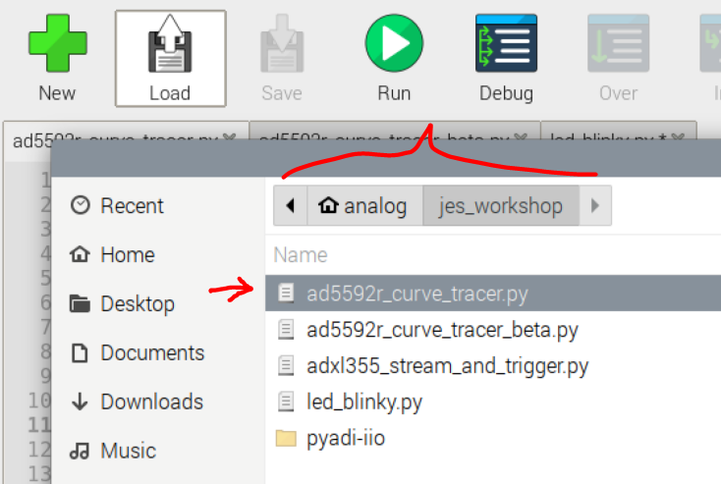
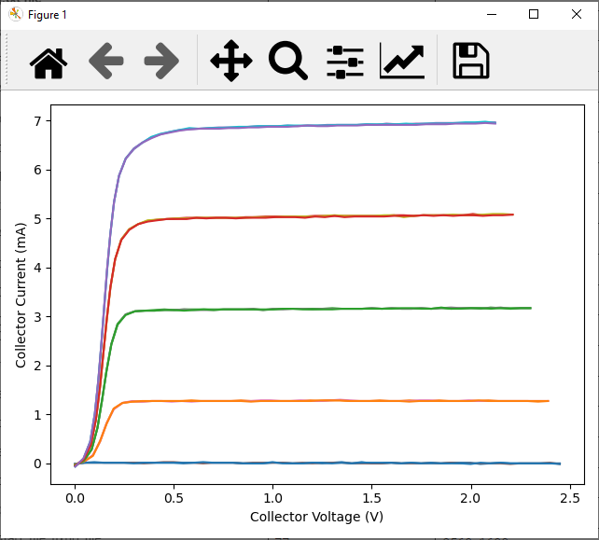
Fred in the Shed’s Proof of Concept!
In Thonny, Open: ad5592r_curve_tracer.py
(See Screenshot)
Run!
Take some time to look through the code, it’s heavily commented
Ask questions!
What other “beyond simple data capture” customer use cases come to mind?
Print Me

Slide 34
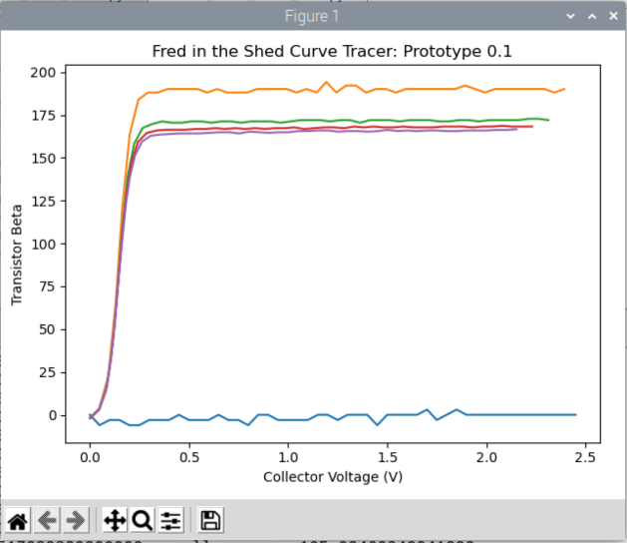
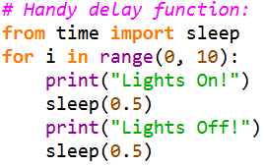
Contest Time!
Write a simple script to blink the light red and green
--OR--
Edit ad5592r_curve_tracer_contest.py to plot beta (hFE) instead of collector current
First to do either of these gets a prize!
Work with your neighbors if you want, we have lots of U-solder-it op-amps ☺
Let’s allocate some time for this (adaptable)
If you’re lost – explore the main curve tracer script and ask questions, in order to get found.
Print Me

Slide 35
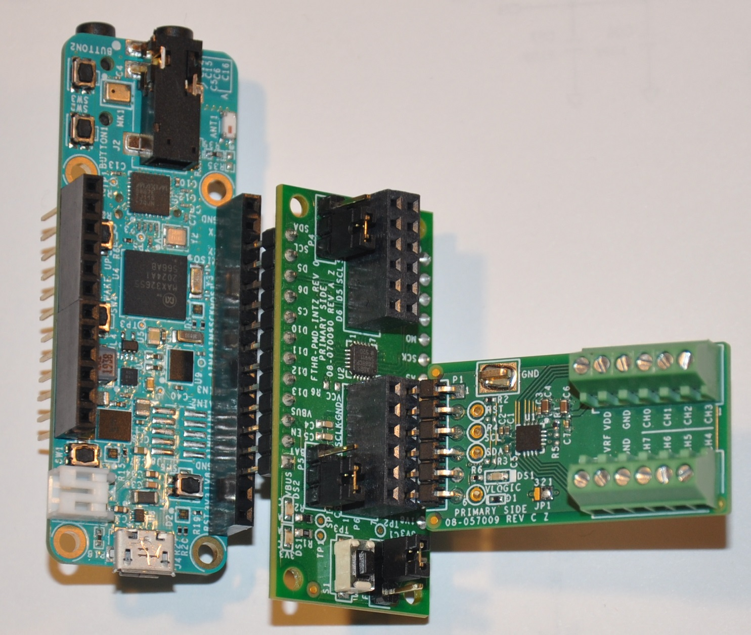
Where can Fred go from here?
Build up ten pilot units using Raspberry Pi Zero 2 Ws (no recompiling necessary!)
Stick with Linux, migrate to 96Board, BeagleBone, or other Pi alternative (that you can actually get these days)
Build no-OS example project on ADICUP3029 or Max feather
Run our Python curve tracer to prove out hardware
Migrate toward embedded application
FTHR-PMD-INTZ
EVAL-AD5592R-PMDZ
MAX32655FTHR
(no-OS)
(These are all orderable part numbers)

Slide 36
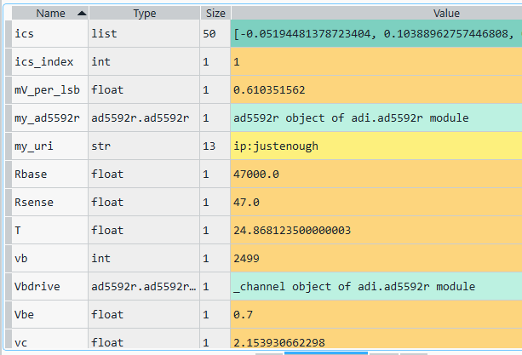
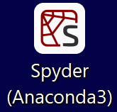
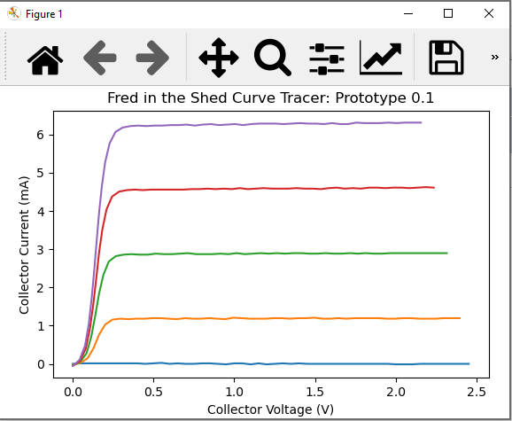

But I want to use PyCharm (or Vscode) on my laptop ☹
Windows, Linux, Mac host
Raspberry Pi
Cushy,
bloated IDE
(unlike Thonny)
iiod server
libiio
pyadi-iio
/sys/bus/iio/../../
pylibiio
Device Driver
Platform Driver
HW peripheral (SPI, I2C, JESD)
ADC, DAC, etc.
Wired network, wireless, serial, USB
Ask me for a live demo!

Slide 37
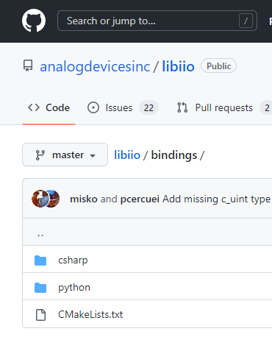
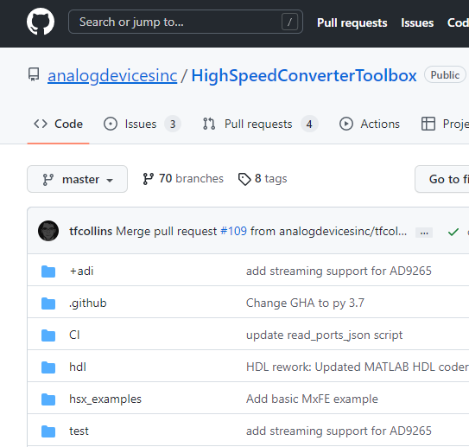
But I want to use C++ or C# or MATLAB
Windows, Linux, Mac host
Raspberry Pi
Application written in your favorite language
iiod server
libiio
libiio language bindings
/sys/bus/iio/../../
libiio
Device Driver
Platform Driver
HW peripheral (SPI, I2C, JESD)
ADC, DAC, etc.
Wired network, wireless, serial, USB

Slide 38
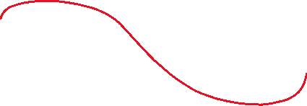
Porting to embedded platform
Windows, Linux, Mac host
Cushy,
bloated IDE
(unlike Thonny)
MAX32XXX
pyadi-iio
tinyiiod server
pylibiio
no-OS Device Driver
no-OS Platform Driver
HW peripheral (SPI, I2C, JESD)
ADC, DAC, etc.
Wired network, wireless, serial, USB
This is where the no-OS hands-on comes in

Slide 39




Porting to embedded platform, embedded application
MAX32XXX
Possible prototype display
Display driver, UI, buttons, blinkies
Algorithms, number crunching
no-OS Device Driver
no-OS Platform Driver
Same as previous slide
HW peripheral (SPI, I2C, JESD)
ADC, DAC, etc.
tinyiiod server

Slide 40

Other examples of “Just Enough Software”
Remember this slide? Let’s look at some real examples…

Slide 41









“The Phaser” ( wiki.analog.com/phaser )
ADALM-PLUTO
FPGA
ARM
USB 2.0 OTG
USB RPi
HB100
Whole system encompasses two contexts, 5 devices
Prototyped with eval boards, raspberry pis, hacked userspace drivers
Migrated to single-board, pushed a few Linux drivers “to the finish line”
SW developed on Windows laptop, but runs on the Pi, too!
GPIO & SPI From RPi
HDMI From RPi
USB From RPi
https://commons.wikimedia.org/wiki/File:RaspberryPi_4_Model_B.svg

Slide 42


Notice a difference?
Code Differences between eval board prototype and production board:
Zero.

Slide 43


Phaser Snippets
Pluto’s IP address
Set up ADAR1000 element mapping
Raspberry Pi’s IP address
Receive data, sum channel 0 and 1, take FFT, then plot
Notes:
After studying the curve tracer code, this shouldn’t look too intimidating. There is subtlety under the hood, but… you should be able to get oriented pretty quickly, and then turn around and orient your customer.

Slide 44



CN0569 Gesture Sensor (ADPD1080)
cn0569_theremin_module.py
Theremin Application
(uses simpleaudio Python module)
adpd2140_gesture_sensor.py (Algorithms, number crunching)
Pyadi-iio
Pylibiio (or C#, or MATLAB, etc)
libiio
Serial Port
Tinyiiod server
ADPD1080.c (no-OS driver)
Platform Driver (I2C)
ADPD1080
Notes:
The CN0569 is essentially an implementation of the flowchart in the ADPD2140 infrared light angle sensor
thought process behind the CN0569 architecture was that if we were to embed the algorithm into the processor, the first question customers would ask is for modifications. Customers can do this themselves, but it involves setting up the ADICUP3029 toolchain and getting familiar with the project structure. Some customers can handle this, others will find it an annoyance.
Thus we implemented the project as a tinyiiod server on the ADICUP3029 board, with all of the intelligence implemented in Python on a host PC. This makes it super easy for a customer to make changes, figure out exactly what they want, THEN migrate to a fully embedded solution.

Slide 45


LiDAR Platform GUI
Written by Signal Conditioning Apps engineer after spending a few hours playing with a Pluto
Bare-bones, but written on a solid framework
Notes:
Noe Quintero (LiDAR application engineer) spent a few hours with the Pluto, then cranked out a usable customer-facing GUI in a matter of days.
Punchline: This all looks pretty similar from the software viewpoint.
Facilitates this conversation:
Customer: “Can I have the GUI source?”
ADI: “Sure, you’ll probably want to write your own top application, but everything at libiio layer and lower is production worthy.”

Slide 46



Another example: ADC PSRR development
Notes:
Don’t let this freak you out. Look at what we’ve got here – a few tens of lines of Python code, implementing a full-blown network analyzer!
This is a real example – In developing a methodology for measuring the PSRR of mixed-signal components, in order to answer a very important question: “Do I REALLY need an LDO on every single supply rail?”
Fundamentally, this measurement involves corrupting a power rail with a known frequency, measure the effect on the output data. The effect may be subtle, and may not even be in the analog domain (like bit error rate, or other parameter.)
So in order to get to proof-of-concept, we distilled the problem down into elementary steps:
Wiggle a signal generator at some frequency / amplitude / waveform
Capture data
Perform some dummy analysis (to be replaced by actual PSRR calculation math)
Step and repeat.

Slide 47



Another Example: AD7124 signal chain SciPy paper
SciPy 2021 paper, uses pyadi-iio and libm2k for a fairly thorough noise analysis.
Lots of useful tips and tricks, easy to replicate on your workbench
Easily applied to almost any ADC w/ pyadi-iio support
https://conference.scipy.org/proceedings/scipy2021/adi_sdg.html

Slide 48
Extra Hands-On Experiment
Monday session immediate feedback: More hands on.
Anyone notice that there was an extra dtoverlay line in config.txt?
This overlay re-configures the AD5592r outputs, with CH2 and CH3 configured as GPIO Outputs, and exposed via one-bit-adc-dac IIO driver. Take a look at the dts file, it’s in the project directory.
Aside from blinking lights, playing with this demonstrates the idea of multiple subsystems (IIO and GPIO) on a single device.
There is an “analog issue” to contend with – CH1 is configured as an analog output, which “fights” with CH2 through the 47 ohm sense resistor.
There is a “digital issue” with the pyadi-iio interface – bug fix in progress.
If we’re feeling adventurous, let’s forge ahead “in real time”.

Slide 49
Reconfiguring for extra experiment
Open a terminal, enter the following:
cd jes_<tab> <enter>
mousepad config.txt <enter>
Edit local config.txt, un-comment ad5592r overlay
sudo cp config.txt /boot <enter>
Enter super duper secret password: “analog” (without quotes of course)
sudo reboot <enter>
While we’re here… mousepad the rpi-ad5592r-with_gpios-overlay.dts file.
Print Me

Slide 50


Extra Experiment snippet
<<WIP – either find a way to get onto Pis, or just run interactive in Python console>>
channel[3] (DAC)
gpio_ch_2
gpio_ch_3

Slide 51

While we are brainstorming, another possibility…
Use IIO Oscilloscope to measure the room temperature of the AD5592, and temperature pinching the AD5592 between fingers (ESD safe ☺) Ground yourself to the little loop first…
Write a script to drive the LED green at room temp, red when pinched.
Pseudocode:
CH3 = 2048 + nominal temp * constant (>4095 not allowed)
CH2 = 2048 – nominal temp * constant (<zero not allowed)

Slide 52


Code Snippet

Slide 53


Call to Action!
The next time you’re selling an ADC/DAC/temp sensor/gyro/IMU/etc… see if it’s supported in Kuiper and / or pyadi-iio… If it is:
Set up and run the example
Show the running setup to your customer
Work with them to write “just enough software” to advance their development process (and get YOU closer to a design-in).
If an example doesn’t exist, ask.
Where? Start with the RDC: https://analog.brightidea.com/RDC
Mixed Signal Dry Spell? Pick an interesting example and play.

Slide 54

Parting Thoughts: Achieving Proficiency
For better or worse, most of us won’t instantly turn into software engineers.
Proficiency as a user comes from getting your hands dirty, corrupting SD cards, seeing the “Raspberry Pi Screen of Death”, breaking stuff…. And then recovering.
EVERY time you encounter a part supported by Kuiper, RUN THE EXAMPLE, then show your customer how to do it.
Raspberry Pi “RSOD” (Rainbow Screen of Death)

Slide 55

Acknowledgements
https://github.com/analogdevicesinc/libiio/graphs/contributors
https://github.com/analogdevicesinc/pyadi-iio/graphs/contributors
https://github.com/analogdevicesinc/adi-kuiper-gen/graphs/contributors

Slide 56

Thank You! <and/or> Questions? <and/or> Section Slide

